Slide 1
National
BUDGET REVIEW Process
Key Stage 3 & 4

Slide 2


Check your knowledge…
What is National Budget?
Why do we need it?
Who comes up with the Budget?

Slide 3

What is the National Budget?
“a financial plan of the government's estimates for revenue, expenditure and borrowing for a specific period, typically a fiscal year”
Notes:
It serves as a comprehensive financial roadmap for the government outlining its fiscal policy of how it intends to allocate resources to various sectors, programs, and services.

Slide 4

What is included in National Budget?
Projected revenues and expenditures
Statement of actual revenues and expenditures of the preceding year
Economic Forecasts or Projections such as GDP growth, inflation, etc.
Allocation of Funds to various sectors based on priorities

Slide 5


Revenues vs. Expenditures
  Tax Revenues
  Non-Tax Revenues
  Grants
  Social Services and Welfare
  Infrastructure and Development
  Security and Justice
  Administration and Governance
  Environmental and Cultural
Revenues
Expenditures
Notes:
Revenues include
Tax Revenues (Eg: Tourism goods & services tax, business & property tax, general goods & services tax, etc)
Non-tax revenues (Eg: Fees, fines,, resort rent)
Grants (Eg: Foreign Aid and funds)
Expenditures include:
Social Services and Welfare: (Education, Healthcare, Social Services, Pensions and Social Security
Infrastructure and Development: (Infrastructure, Transportation, Housing and Urban Development, Economic Development)
Security and Justice: (Defense and Security, Public Safety, Justice and Legal Services)
Administration and Governance: (Public Administration, Public Debt, Subsidies and Grants,)
Environmental and Cultural: (Environmental Protection, Cultural and Recreational Services, Research and Development)
International Engagement: (Foreign Aid)
Emergency Response and Crisis Management:

Slide 6
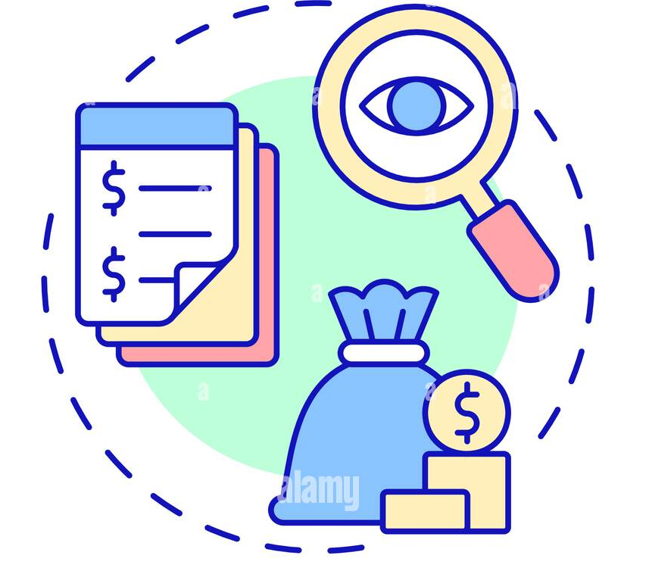
What is the role of Majlis in the Budget Review Process?
How is it done?

Slide 7
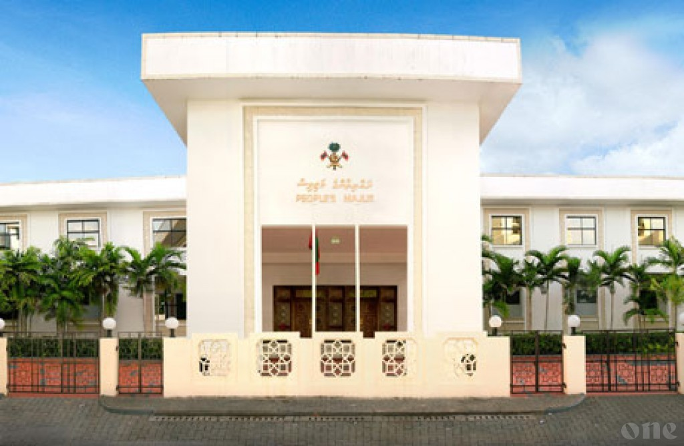
Role of Majlis
One of the main responsibilities of Majlis = approve or pass National Budget
It ensures that financial decisions align with the priorities of the people
Essential for maintaining transparency and accountability

Slide 8
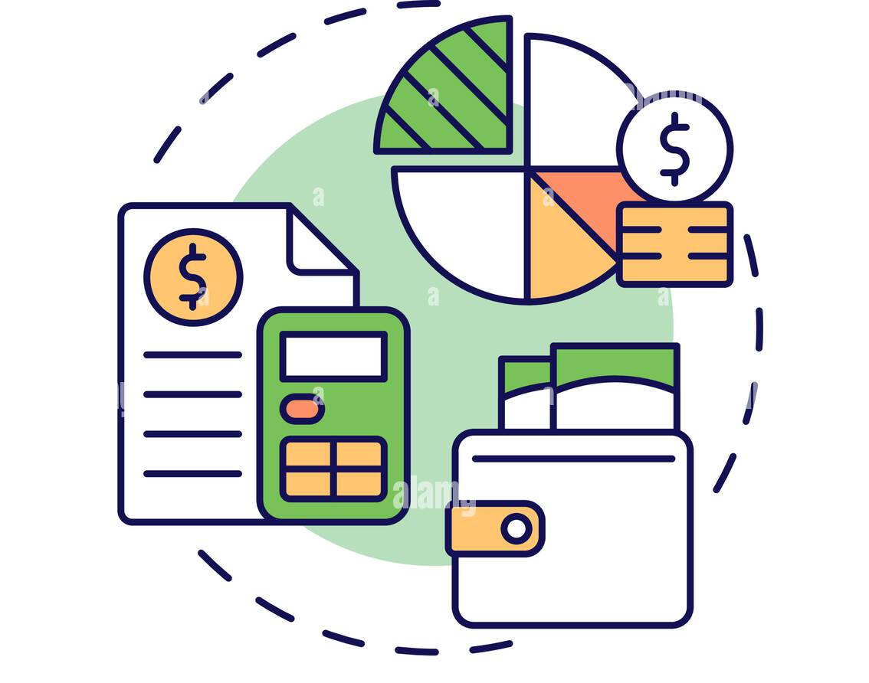


Stage 1
Preparation of Budget
The government prepares the budget.
It involves:
  estimating revenues and expenses
  setting financial priorities
  setting allocations for various programs/ areas
Stage 1
Stage 2
Stage 3
Stage 4
Stage 5
Stage 6

Slide 9

Stage 2:
Presentation to Majlis
Minister of Finance submits the projected budget before 1st November.
members present their views and inquire to Minister
Then, it is sent to the Budget Review Committee
Stage 1
Stage 2
Stage 3
Stage 4
Stage 5
Stage 6
Notes:
The budget document provides detailed information on revenue sources, expenditure proposals, and the economic outlook.
Budget Review Committee is composed of two standing committees. That is Committee on Public Finance and Committee on Economic Affairs

Slide 10
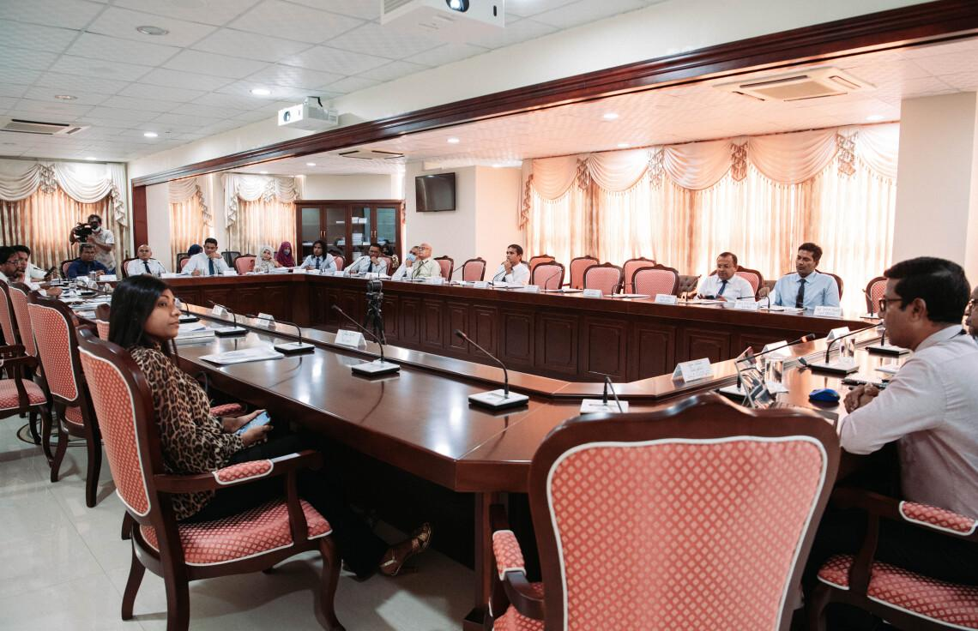
Stage 3:
Budget Review Committee
Holds discussions / seek written clarifications from various stakeholders such as: Minister of Finance, Governor of MMA, Auditor General and other state institutions
Considers opinions expressed by MPs during budget debate time
Stage 1
Stage 2
Stage 3
Stage 4
Stage 5
Stage 6

Slide 11
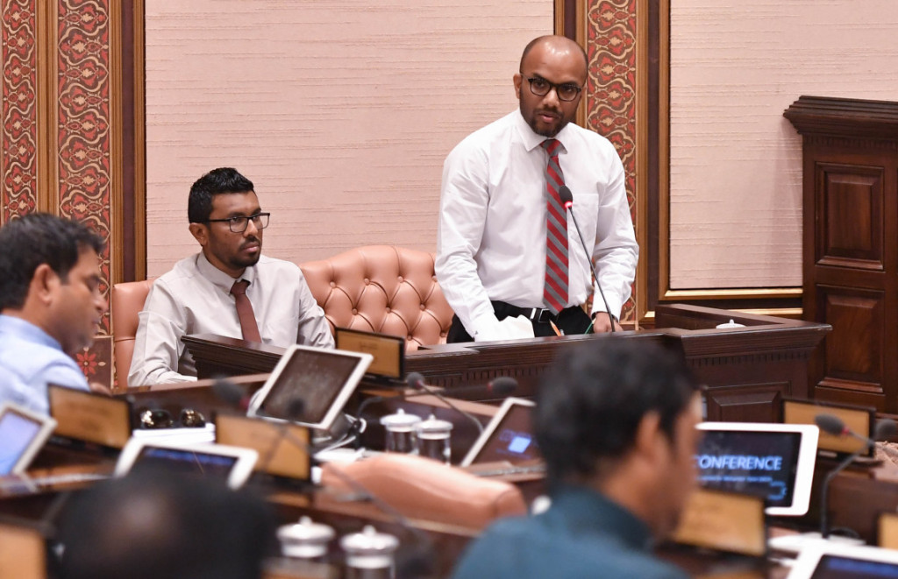
Stage 4:
Budget Debate
Majlis must begin its debate 7 days after submission.
Finance Minister answers any queries from MPs
All the views expressed is sent to the Budget Review Committee.
Budget Review Committee submits Committee Report to the Majlis 7 days before the end of Majlis Sessions for that year
Stage 1
Stage 2
Stage 3
Stage 4
Stage 5
Stage 6

Slide 12
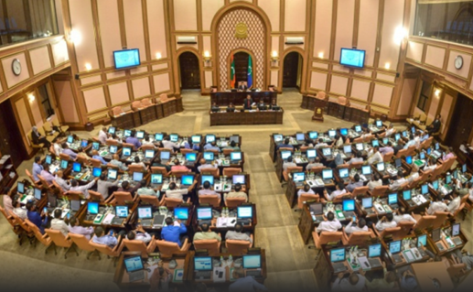
Stage 5:
Amendments
Based on the report of Budget Committee, MPs engage in debates.
MPs may propose amendments to the budget.
Majlis votes on any amendments.
Stage 1
Stage 2
Stage 3
Stage 4
Stage 5
Stage 6

Slide 13


Stage 6:
Approval of Budget
After the budget has been debated and any necessary amendments made, Majlis votes to approve the budget.
Stage 1
Stage 2
Stage 3
Stage 4
Stage 5
Stage 6

Slide 14

www.budget.gov.mv
Questions?
For sample budget report and more ideas, explore

Slide 15

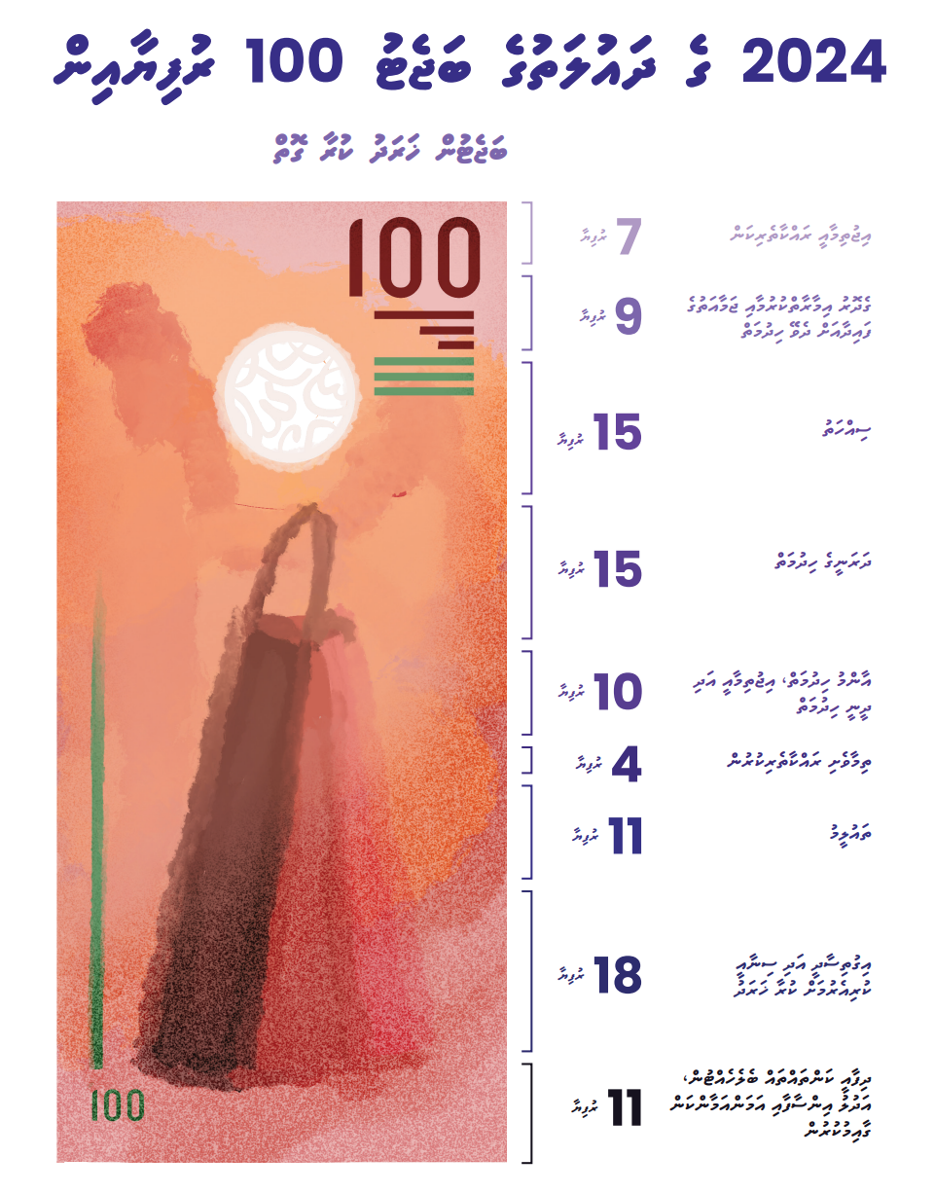
STATE EXPENDITURE CATEGORIES
Social Protection
Housing and Community Amenities
Health
Debt Services
General Public Services
Recreation Culture and Religion
Environmental Protection
Education
Economic Affairs
Defense, Public Order and Safety
Activity

